Slide 1
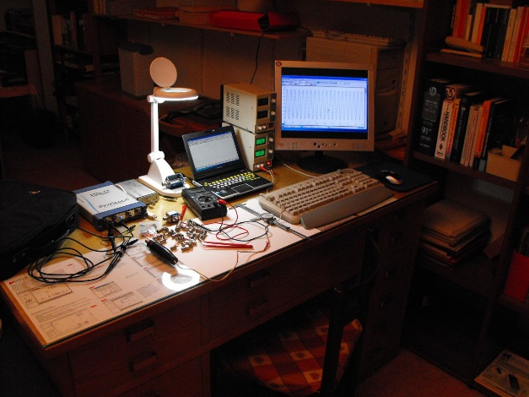
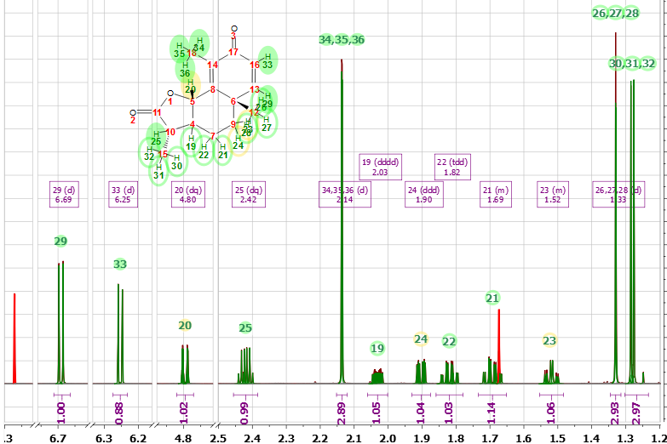
Is NMR Stuck? Original title: NMR Technology: Recent history, emerging possibilities and new challenges
Stanislav Sýkora == Stan’s Hub (www.ebyte.it)
Who am I: a physicist, NMR buff, retired entrepreneur, programmer, OBSERVER
Experiences: Academic (11 y), head of Bruker Italiana (6 y), cofounder of Stelar (20 y)
Acquired my first NMR spectrum in February 1964, and did NMR ever since.
Sold, installed and serviced over 100 instruments (and designed some of them)
Currently: since 2000, running Extra Byte and working closely with
Mestrelab Research on Mnova NMR spectroscopy software
Why am I telling you all this crap about myself?
Because I want to raise a provocative question, namely
Is NMR Stuck?
Bread & butter
Hobby
Presented at MRPM13, Bologna, Italy, 4-8 September 2016 Slides are available at DOI 10.3247/SL6Nmr16.001

Slide 2
My personal perception is that there is indeed something WRONG with NMR
It looks so on all points that matter:
Theory
Technology
Applications
Industry
Market
Jobs
Does this sound as a provocation? Well, it is one!
But let me to explain what I mean
Presented at MRPM13, Bologna, Italy, 4-8 September 2016

Slide 3
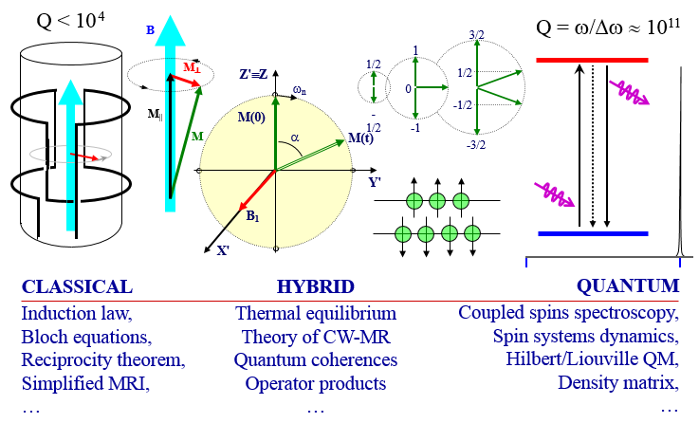
The current state of basic NMR theory
We use very different explanations for different aspects of NMR phenomena!
Yet, with few exceptions, nobody seems to be worried by that
The problem started already with the founding fathers (I. I. Rabi, F. Bloch, M. E. Packard, E. M. Purcell, ...) who used conflicting terminologies and not-so-clear explanations. Later, R. H. Dicke pushed an incorrect ‘interpretation’ of FID. The problem was also tackled by J. Jeener using QFT, re-attacked by D. Hoult and by myself, but it remains ... unsettled

Slide 4
NMR technology and methodology - once
NMR progressed briskly from mid-50’s to the end of 80’s.
There was the introduction of active shimming to achieve high resolution (M. Golay, W. Anderson), field stabilization by NMR lock (M. E. Packard), introduction of the spin Hamiltonian (W. Anderson) and its full elucidation in molecular spin systems (several people), 13C NMR (P. Lauterbur), FT spectroscopy (W. Anderson, R. Ernst), attaching a computer (!) to an instrument (then a shocking idea, pushed by R. Ernst), discoveries like those of NOE and DNP (A. Overhauser, C. P. Slichter), an infinity of pulse sequences to do this and that (too many people to name), elucidation of chemical structures by NMR (too many people again), all the way up to elucidation of protein structures and shapes (K. Wuetrich), etc
For decades, we kept being awed and amazed!
In early 80’s, somewhat belatedly, MRI was added (P. Lauterbur, P. Mansfield, R. V. Damadian) and soon became an immensely successful new application. It became a separate area, one which I will NOT cover in this talk.
Presented at MRPM13, Bologna, Italy, 4-8 September 2016

Slide 5
NMR technology and methodology - today
Things have changed a lot at some point in the last 20 years.
I believe that in the last decade I have not heard nor read anything that, more or less, glossing over minor variations, I have not heard already a decade earlier.
By and by, I realized that I was no longer getting amazed!
Two decades are a whole generation.
So, without the amazement,
Why should young people of today go into NMR?
To make a carrier and earn money to make ends meet?
There are more efficient ways to do that!
Presented at MRPM13, Bologna, Italy, 4-8 September 2016

Slide 6
NMR applications and markets
NMR kept blooming in an amazing way from mid 50’s up to about mid-90’s. Mostly because of new branches of chemical NMR spectroscopy, and then because of MRI. New sequences for this and that, ... Hundreds of them! And proteins sequencing!
NMR was such an evergreen!
We were also continuously reminded that hundreds of NMR applications were possible and it made us think that they were on the way to soon become real and important even in the real world, beyond the Academy. We only had to show that something works and it would automatically spring to life of its own.
Alas! It does not work that way!
Presented at MRPM13, Bologna, Italy, 4-8 September 2016

Slide 7
Current NMR applications and markets
Excluding MRI, practical NMR applications used in non-academic environments (meaning not just in once-only research studies) include:
spectroscopy for chemists (85%),
process-control (5%, still of chemical nature),
well-logging (5%, often home-made),
relaxometry of materials (1%, preferably FFC),
porometry (0.5%),
superconductivity research (0.5%),
... tens of techniques sharing the remaining 3% (food industry, quality control, fraud prevention, historic heritage, MFM, geo-prospecting, ...)
Note: The numbers in parentheses are my estimates and may be quite off in some cases.
Consider also that in most categories,
NMR is in competition with other methodologies, and often a looser
The only application in which NMR plays a unique role is structural organic chemistry. Variable field relaxometry might one day play a similar role in determining molecular dynamics, but much development is still needed on many fronts (NMR, but not only).
Note on the margin:
The world NMR market is below $500 M/year
Many a building Company does more than that!

Slide 8
Early 21st century NMR industry
Major NMR manufacturers are either dropping out of NMR (Agilent) or struggling (Bruker). This opened some possibilities for minors. In particular, Jeol is wedging in, in a very credible way, but focusing 100% on the core NMR spectroscopy market.
There are also new players - quite a few of them. The theoretical feasibility of designing cheap NMR instruments (often relatively low field) activated and/or brought to life a lot of small Companies and investors. But it turned out not to be so simple!
Most of these ventures are focusing on the technology, but copying the same, obsolete technical schemes, while at the same time fighting formidable adverse effects such as weak market, dependency on public funds, limited resources to develop solid applications, etc. In some cases they even lack a market-and-application-oriented business plan. Consequently, many will be short-lived.
There emerges a new paradigm (new to NMR, that is):
Find a marketable application, and your Company will bloom!
Develop just a cute NMR instrument and you will go broke!
Presented at MRPM13, Bologna, Italy, 4-8 September 2016

Slide 9
My advice to the table-top guys
Forget day-dreaming about producing a cute table-top spectrometer for structural organic chemistry, just because you think that you know how to make it cheap.
Chemical structure determination is one successful application with 60 years of development and optimization behind it. It is totally unlikely that you can do it better. Besides, chemists are happy with their 300 – 700 MHz instruments, even when rather obsolete. They are perfect for that task! And their cost is NOT an issue (if they tell you so, do not believe it). A detailed knowledge of the market and of its language is an issue, though, and maybe you are not up to it!
In general, to do a job well, one should use the most fitting tools.
In general, the ideal is to first pinpoint an application and then design the best instrument for it, not the other way round.
Presented at MRPM13, Bologna, Italy, 4-8 September 2016

Slide 10
NMR- related jobs
By a conservative estimate,
some 3000 NMR-related jobs were lost
during the last decade, some 20% of which engineers and scientists.
In absolute terms, that is not so much, but NMR jobs are rare ...
Hardest hit categories:
NMR spectroscopists in large pharma corporations
(Sandoz, GSK, Astra Zeneca, ...)
Engineers, application chemists, and vendors jobs with
large manufacturers (Agilent dead, Bruker restructuring)
Presented at MRPM13, Bologna, Italy, 4-8 September 2016

Slide 11
How I am eroding the middle class
The chemist/spectroscopists in Pharma Companies are driven much as slaves: they get 15 minutes to interpret a spectrum - and they better meet the standard, else ...
The software I keep working on (an NMR AI wizard) can reduce that time by a large factor. Hence they all want it, to help them out. But their managers want it to make many of them ‘redundant’ and to get more work done with fewer people.
In other (bitter) words,
After a lifetime as an NMR enthusiast,
I became an NMR middle-class eroder!

Slide 12
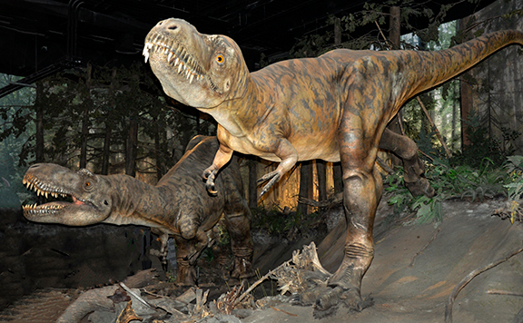
Thank you for your attention and patience
Bruker
New NMR instruments with no application
Presented at MRPM13, Bologna, Italy, 4-8 September 2016 Available at DOI 10.3247/SL6Nmr16.001

